Slide 1
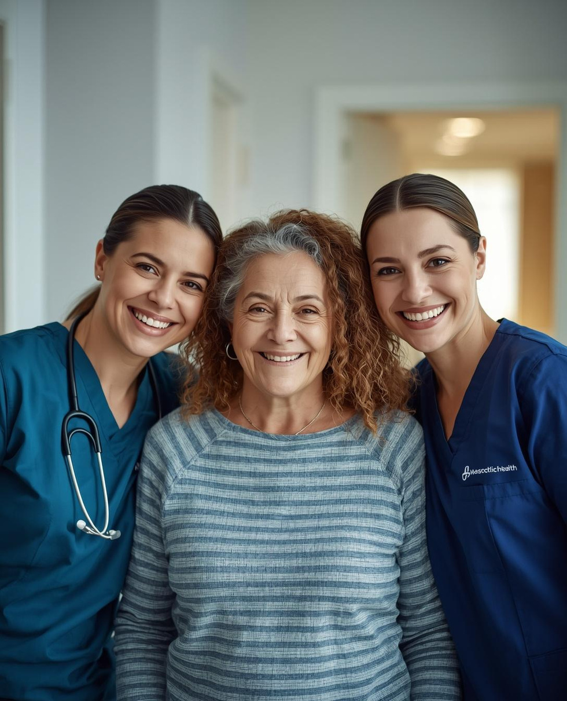


Embedding Personhood in End-of-Life
and Intensive Care
Implementing the SELFY Tool
Notes:
Lynette

Slide 2
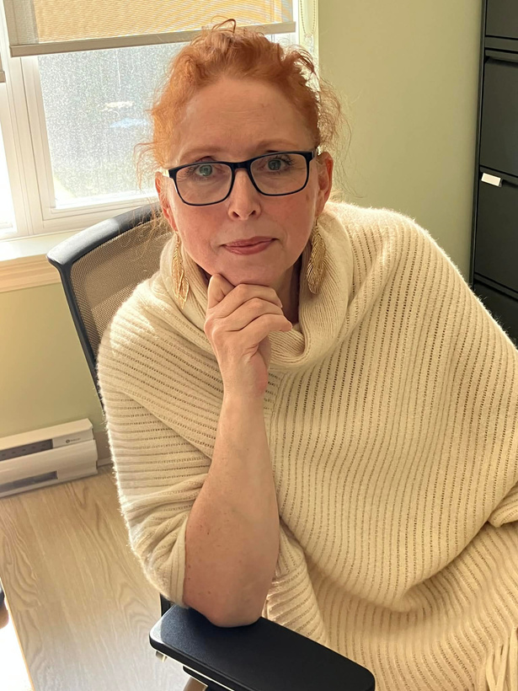
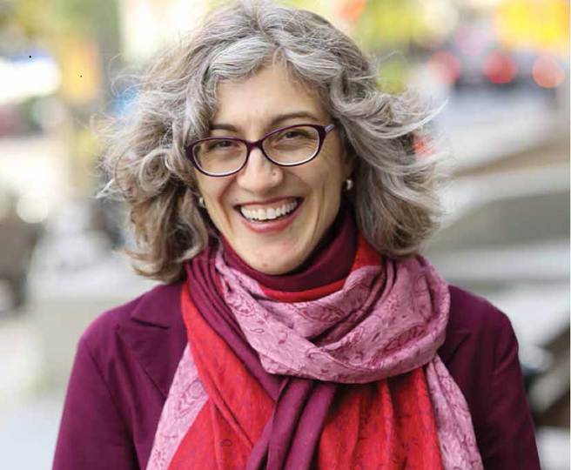
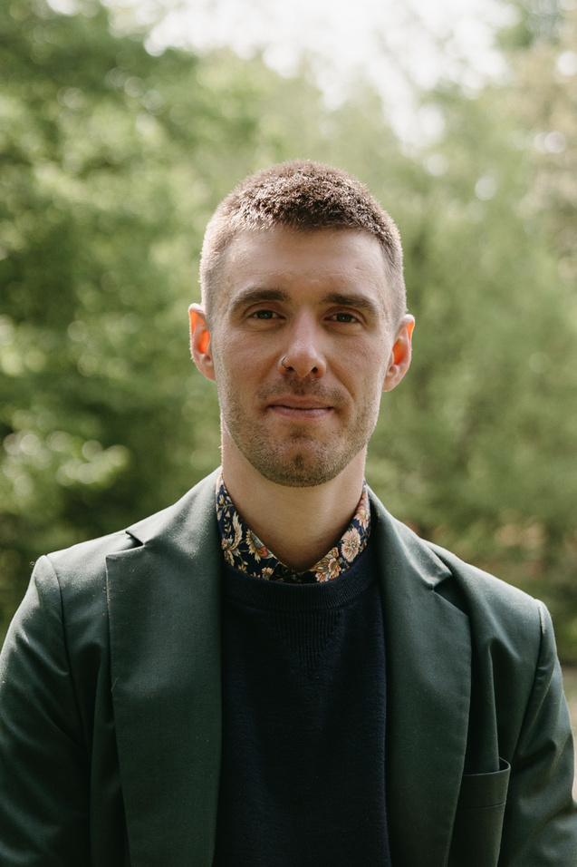
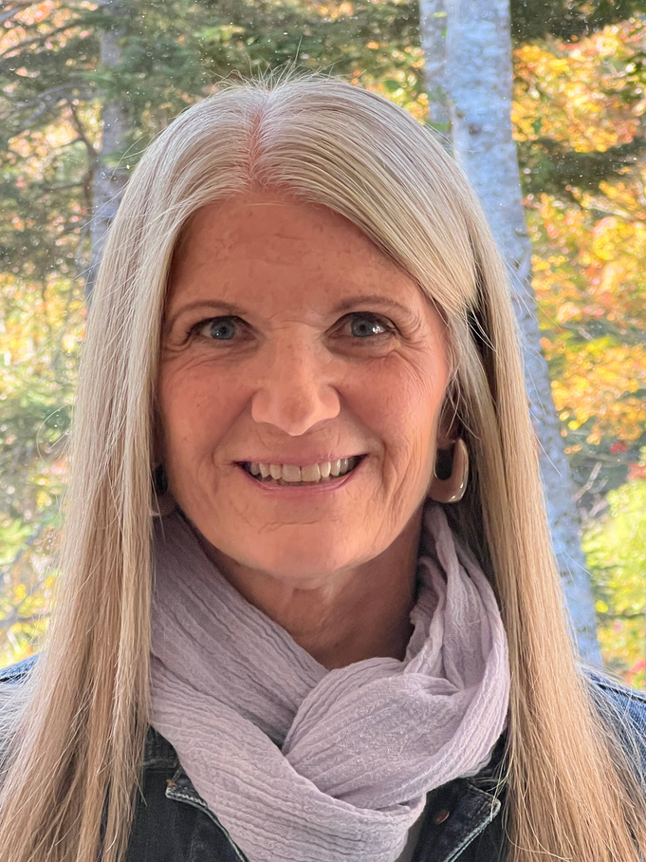
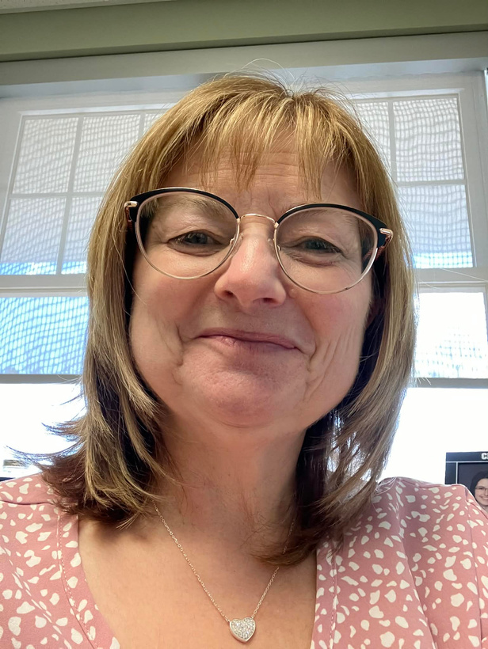
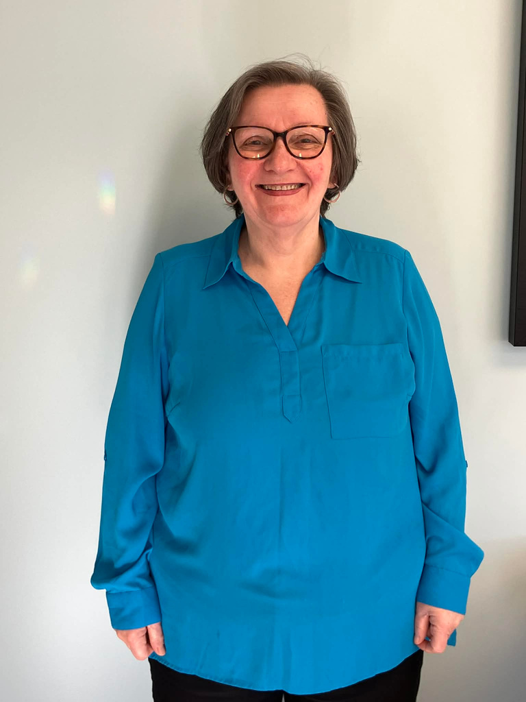
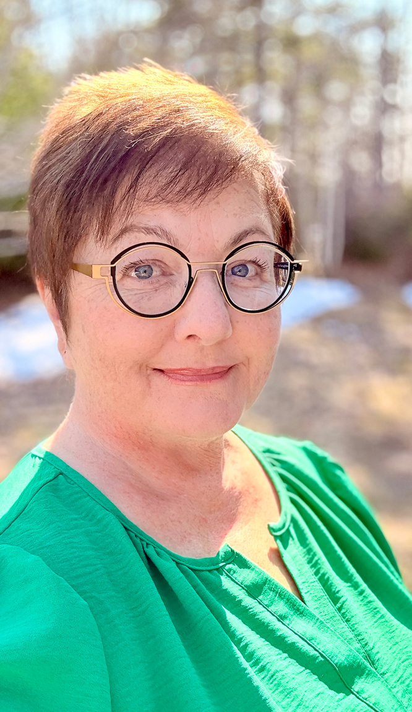
Dr. Mary Ellen Macdonald
Lynette Sawchuk
Dr. Logan Lawrence
Cyndi Corbett
Lisa McNeil-Campbell
Dr. Anne Frances D’Intino
Mary Delaney
Notes:
Lynette
Introduce team
We do want to take a second to acknowledge a former member of this team, John Shaw. He was instrumental in the early stages of this project with conceptualization and information gathering and is a great champion for person-centred care. It wouldn’t have been the same without him.

Slide 3

FUNDING
QEII Translating Research into Care (TRIC)
Planning Grant & Implementation Grant
Notes:
Lynette

Slide 4

03/13
THE HEART OF THE PROBLEM
Person-centered care is the ideal, but not always the reality.
Notes:
Anne Frances

Slide 5
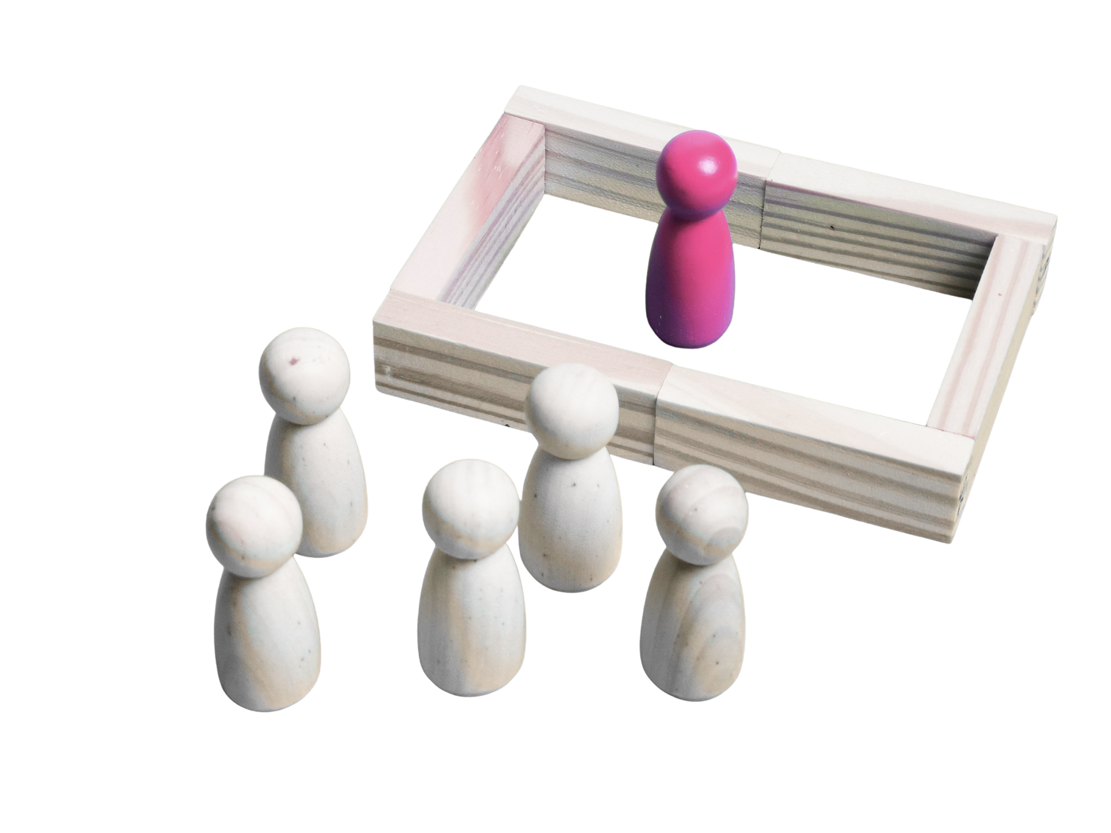
WHAT GETS IN THE WAY?
No practical tools for personhood.
Documentation prioritizes medical information, not identity.
Notes:
Anne Frances

Slide 6
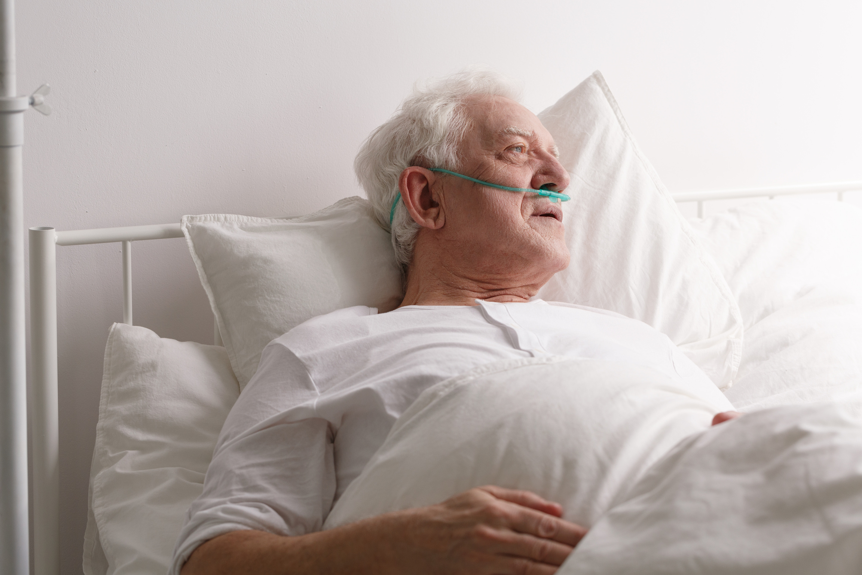
WHO IS THE PERSON IN THE BED?
The SELFY Story
Notes:
Anne Frances

Slide 7
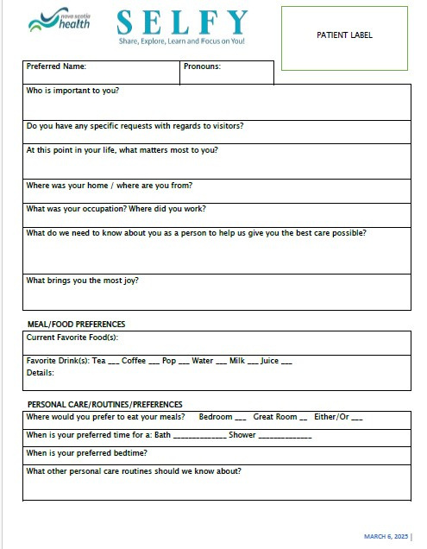
HISTORY OF THE SELFY
GROUNDED IN PRACTICE
Developed by Hospice Cape Breton (2022)
Designed with managers, staff, volunteers, patients and families
Structured yet flexible and can be adapted to the workflow of the environment.
Notes:
Lisa

Slide 8
A TOOL FOR PERSON-CENTERED CARE
06/13
S
E
L
F
Y
H
A
R
E
X
P
L
O
R
E
E
A
R
N
O
C
U
S
O
U
and
on
Notes:
Lisa

Slide 9
WHAT SELFY CAPTURES
I have a golden retriever dog named Jack and a calico cat named Pepsi.
Beyond medical information:
I love hockey and my team is the Toronto Maple Leafs!
What matters to me
Who matters to me
What brings me comfort, meaning and dignity
I was a long-haul truck driver and traveled all over Canada and the US
My favorite food is turkey dinner, fish cakes and spaghetti. I love chocolate ice cream and popsicles
Please make sure I have my rosary beads and my bible next to me.
I am a residential school survivor. Please don’t give me oatmeal.
Notes:
Anne Frances
The selfy is like a conversation, just like we are today.
This is a snapshot of you and there’s someone listening who is interested to learn more about you.
This provides an opportunity for those at the bedside to share in reminiscing about the times gone by and about what matters most now.

Slide 10
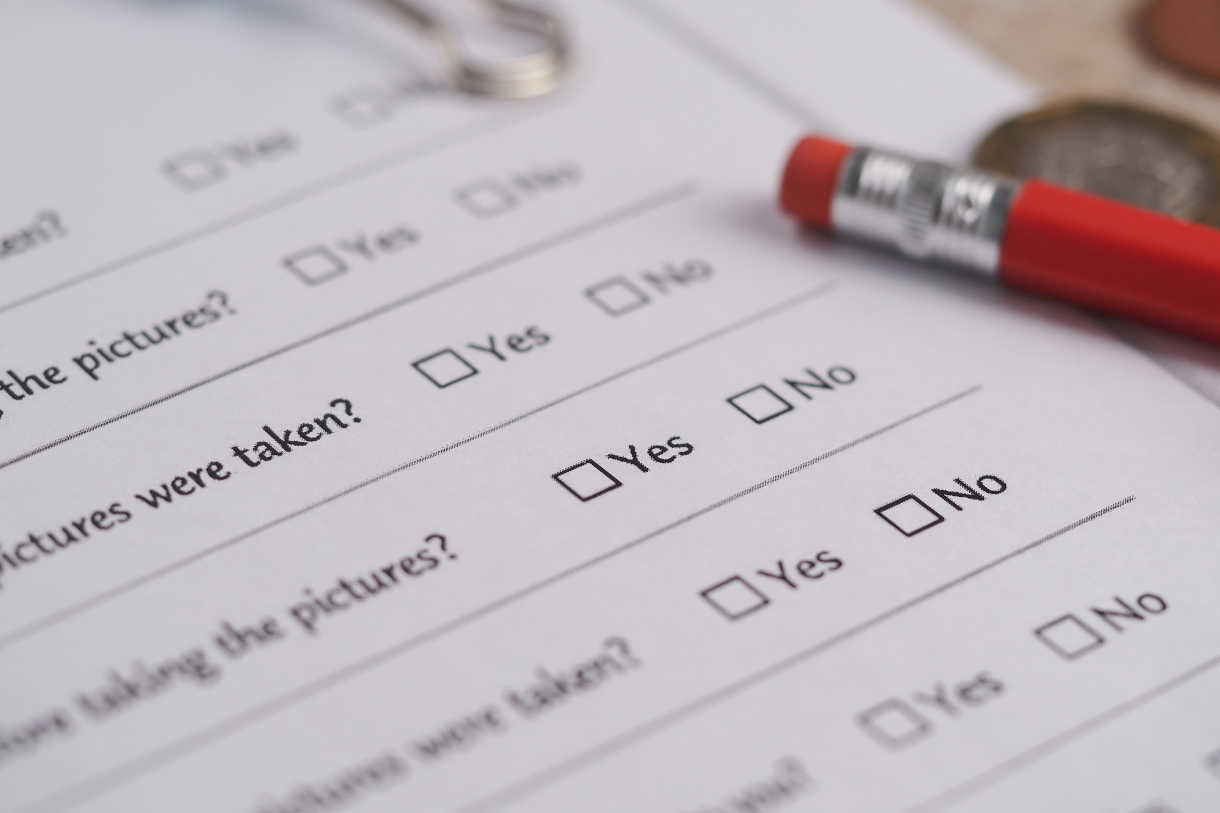

HOW WE STUDIED IT
Literature Review
International Survey
Notes:
Mary Ellen

Slide 11
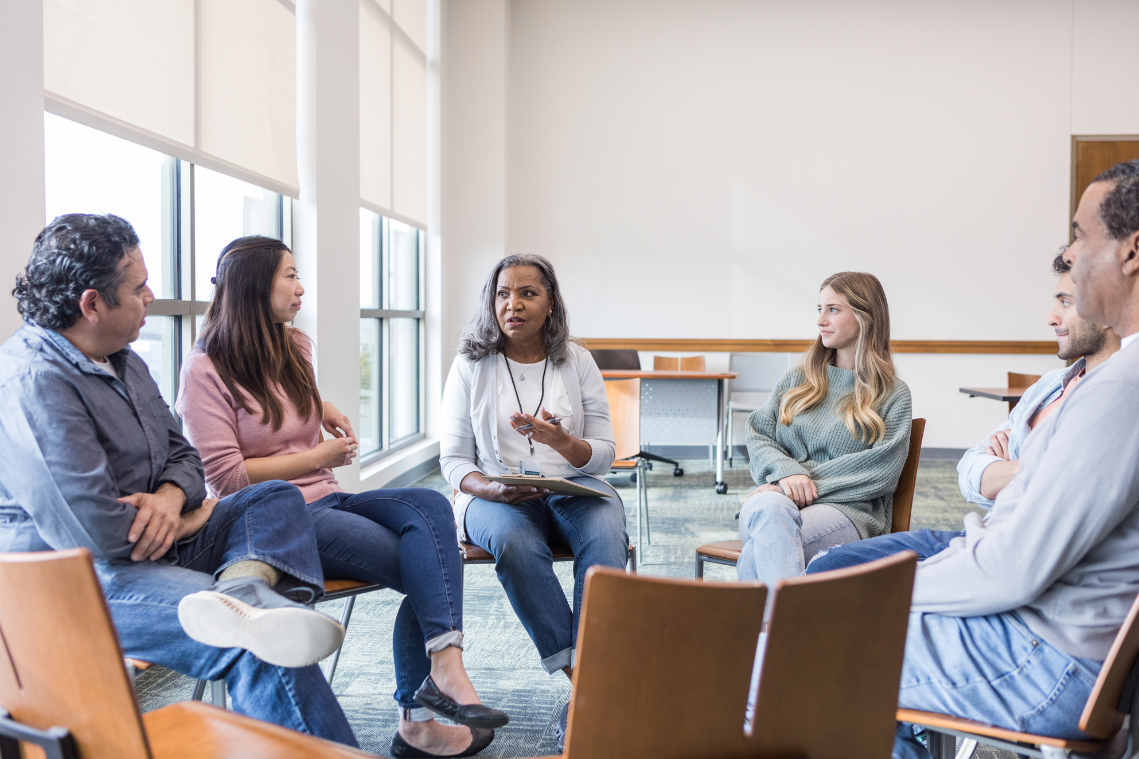

HOW WE STUDIED IT
Listening Closely
Focus group interviews
Patients, families, staff and volunteers
Notes:
Mary Ellen

Slide 12
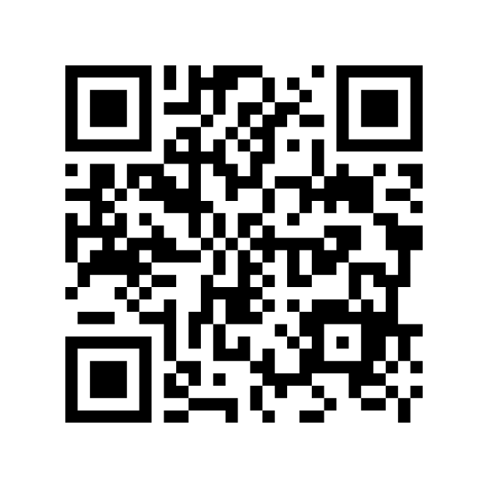
RESULTS
Confirmed dearth of person-centred care tools
Confirmed that the SELFY operationalizes hospice values
Refined the SELFY tool and process
Updated questions
Created “3CU’ toolkit
Notes:
Mary Ellen

Slide 13

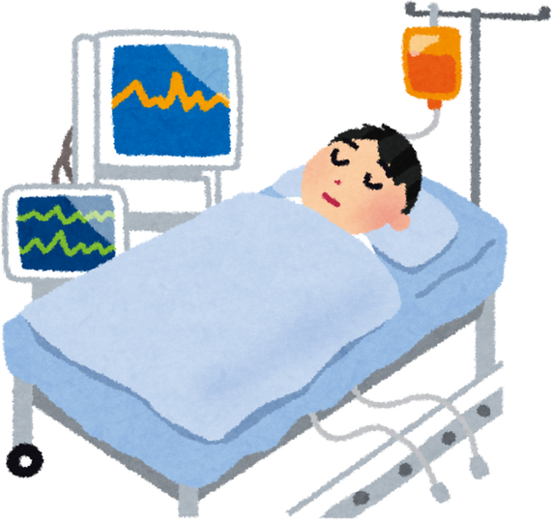

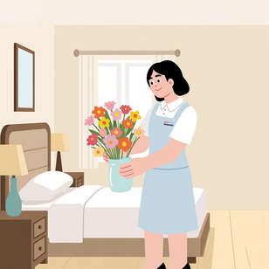
SELFY - SHARE, EXPLORE, LEARN, FOCUS ON YOU
FROM PILOT TO IMPLEMENTATION
Longitudinal, mixed methods design
Five sites across Nova Scotia
Hospice, Palliative Care Unit & Intensive Care Unit
Notes:
Mary Ellen

Slide 14
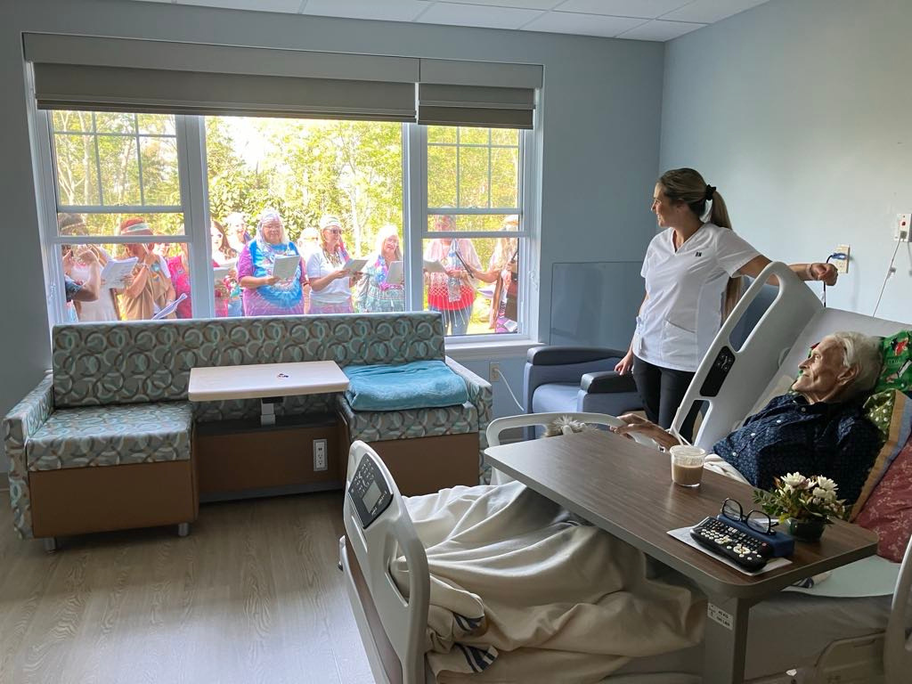

GOAL:
To evaluate the SELFY as a mechanism for embedding person-centred care within diverse settings.
OBJECTIVES:
To determine the SELFY’s effects on staff, volunteers, patients and families
To identify barriers and enablers influencing implementation
To determine how the SELFY can be tailored to maximize patient-centred care
To develop a minimum data set for routine use of non-medical information
Notes:
Mary Ellen and Lisa will pop in to explain what's happening in the photo.

Slide 15

understanding the processes
Iterative, continuous data generation to enable real-time learning and adaptation
understanding the outcomes
End-of-project interviews and focus groups with interest holders (clinical and non-clinical staff, volunteers, and patients and family members)
Notes:
Mary Ellen

Slide 16
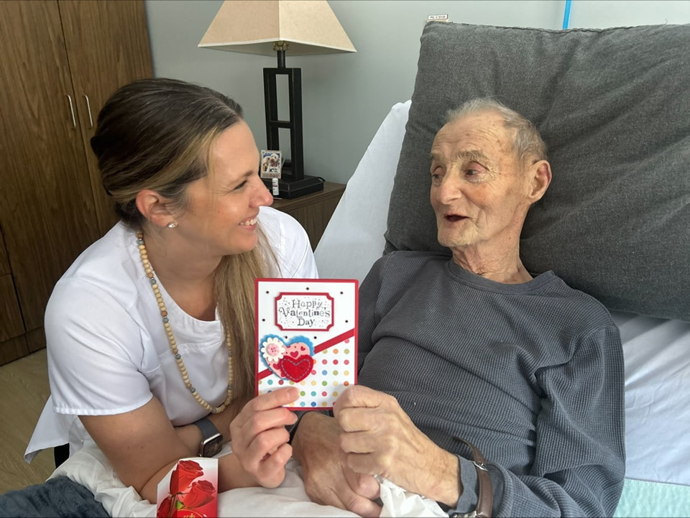
BRINGING IT BACK TO THE BEGINNING
Who is the person in the bed?
Notes:
Lisa

Slide 17
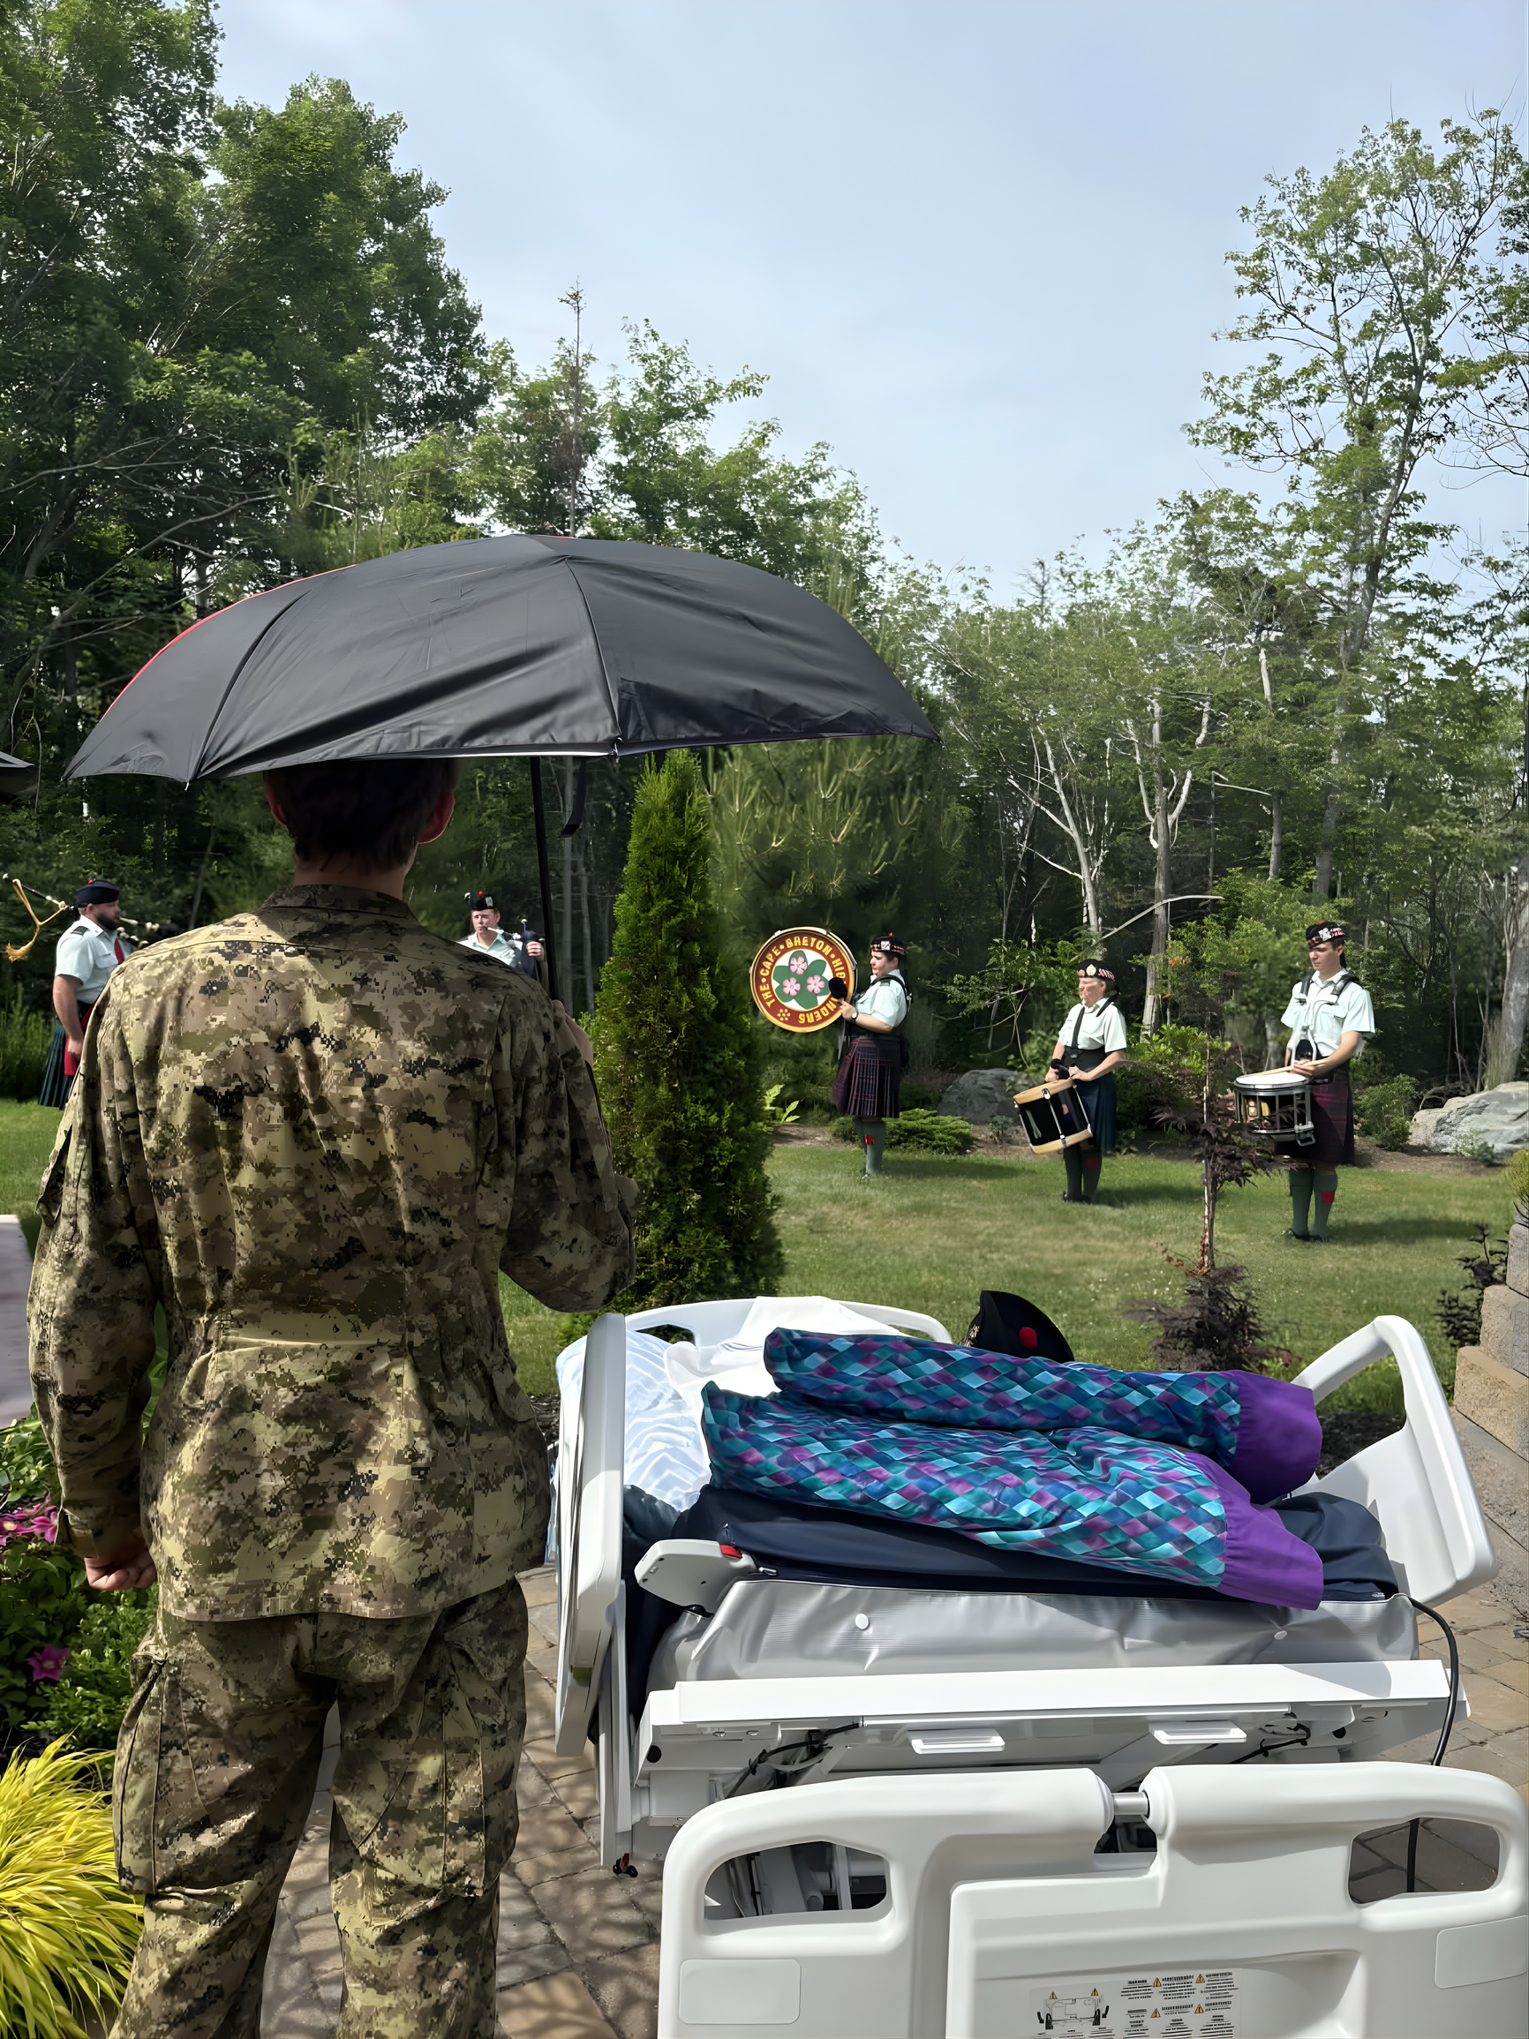

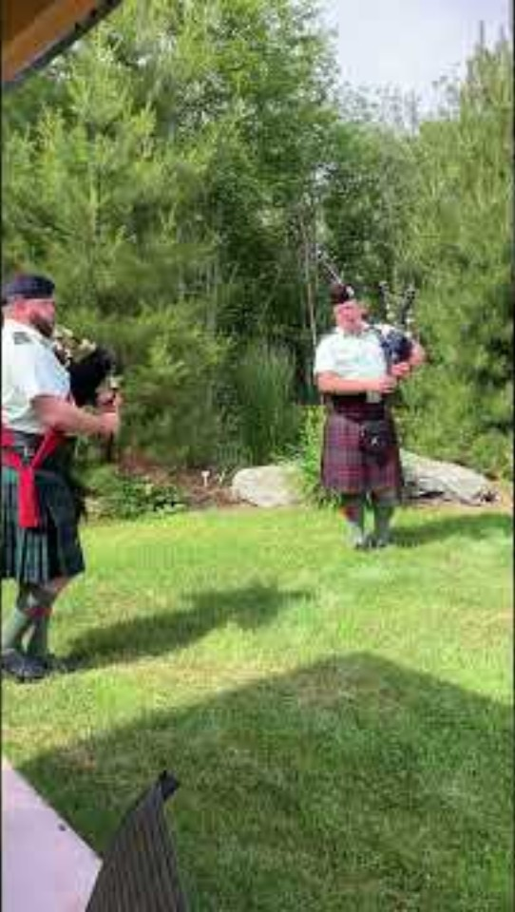
WHAT IF WE ASKED DIFFERENT QUESTIONS?
05/13
Notes:
Lisa
Explain story and play video
None of this would have happened without the SELFY.
What a meaningful experience for the patient and his family and for the staff and those who participated . . . they will never forget that day.

Slide 18
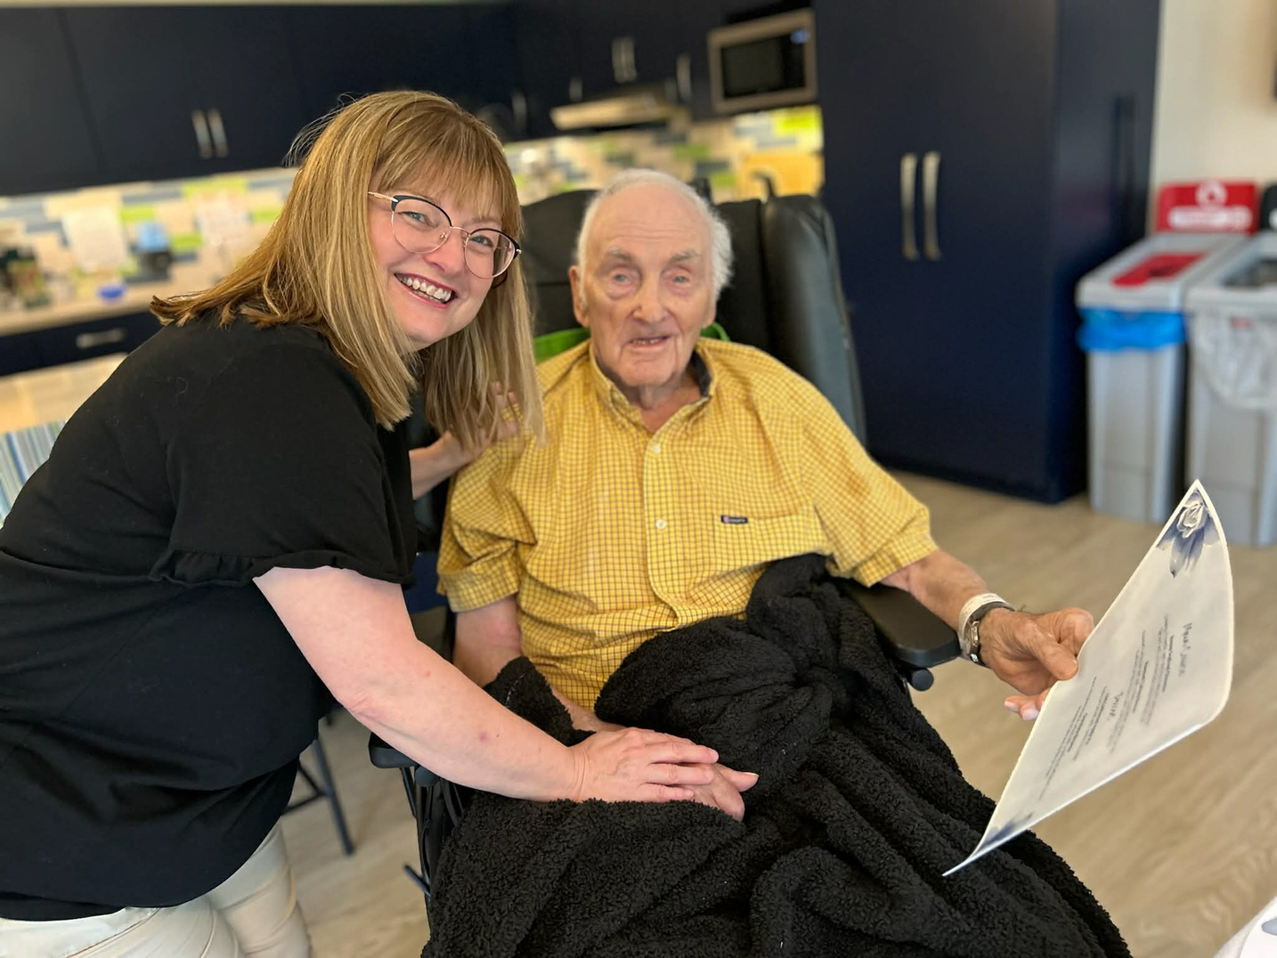
SHARE, EXPLORE, LEARN, FOCUS ON YOU
WHAT WOULD THIS LOOK LIKE IN YOUR SETTING?
Notes:
Anne Frances & Lisa
Now it's time for a little activity:
This is the time to reflect on what you might want people to know about you if you were in the bed. How could we make your day special?

Slide 19

Notes:
Anne Frances & Lisa
Explain the activity.
Lynette and Mary pass out Selfy's to participants

Slide 20
